Slide 1
Logistic Regression
Parvin Sharifi

Slide 2
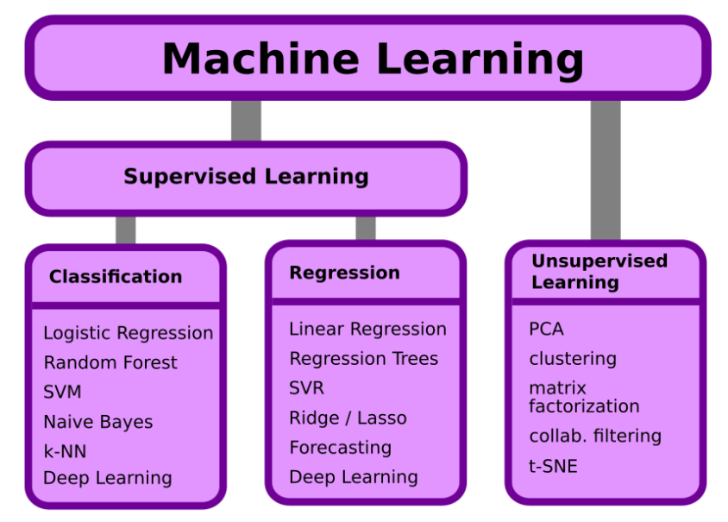
Logistic Regression (Log-Reg)
Logistic regression is a classification method
It is NOT Regression
Log-Reg is a Supervised Machine Learning Model

Slide 3
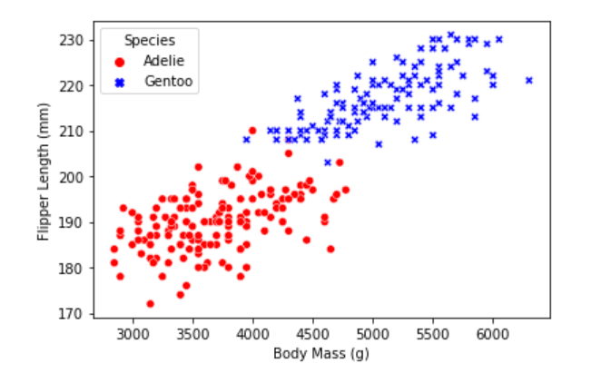
Classification
Adelie has lower body mass and smaller Flipper length
Gentoo has higher body mass and smaller Flipper length
How can we separate the classes with a line or plane?

Slide 4
Which line is better?
Can we do it with our eyes?
What about a computer?

Slide 5
How to adjust the line?
Translation

Slide 6
How to adjust the line?
Rotation

Slide 7
Moving line by its parameters
$ax+\left(b−3\right)y+c<0$
$ax+by+\left(c−3\right)>0$
$ax+by+c=0$
$ax+by+c=0$
$ax+by+\left(c+3\right)<0$
$\left(a+3\right)x+by+c>0$

Slide 8
Class regions
How the computer can evaluate that it chose the best line?
Negative
Positive

Slide 9
Error
The correctly classified points have the error of zero
The error is proportional to the distance of the data points to the line
0
0
0
0
0
Negative
0
0
Positive
0
0
0

Slide 10
Gradient Descent
Minimizing Error
Large Error
Small Error

Slide 11
Gradient Descent
Large Error
Derivative of the error function
Small Error

Slide 12

Log-Loss Function
1
1
1
1
Probability
0
Negative
0
1
Positive
0
0
0
$0.8$
$0.6$
$0.5$

Slide 13
Log-Loss Function
1
1
1
1
0
Negative
0
1
Positive
$ax+by+c>0$
0
0
$ax+by+c=0$
0
$0.8$
$0.6$
$ax+by+c<0$
$0.5$

Slide 14
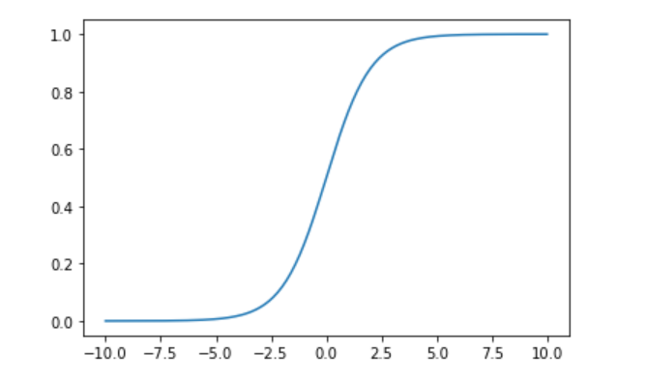

Activation Function (Sigmoid)

Slide 15
Log-Loss Function
1
1
1
1
0
Negative
0
1
Positive
0
Derivative is proportional to the difference between label and prediction
0
0
$0.8$
$0.6$
$0.5$

